Slide 1
AN ARDUINO BASED VEHICLE TRACKING SYSTEM USING GPS AND GSM MODULES
BRIAN KIBET RONOH – P15/81773/2017
SUPERVISED BY DR. KAHONGE

Slide 2
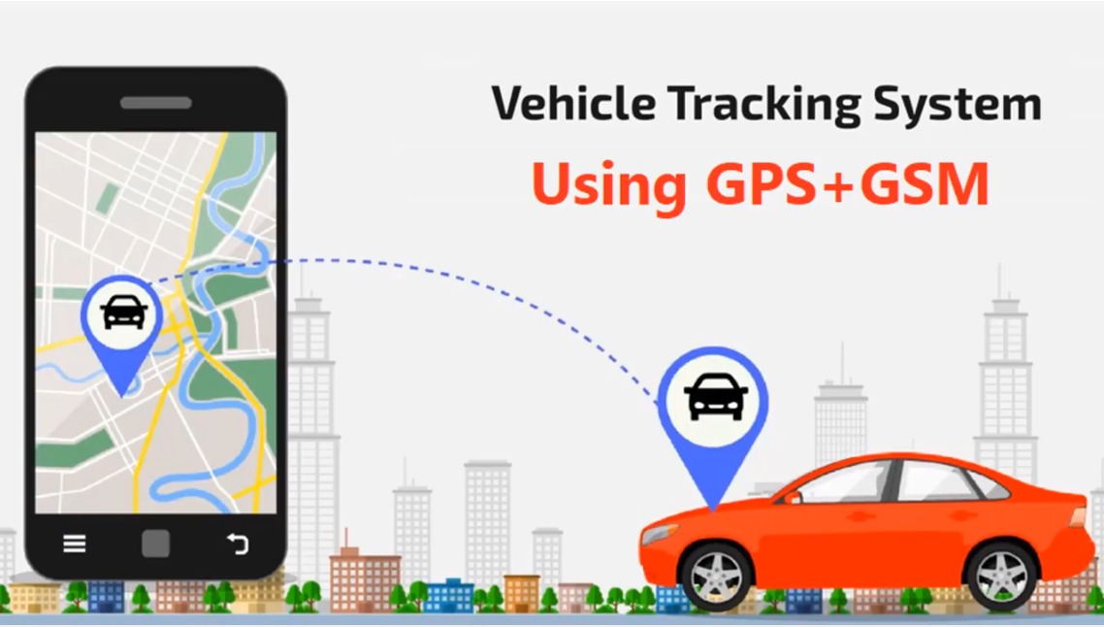

Slide 3
REVIEW OF PREVIOUS ISSUES RAISED DURING PROPOSAL PRESENTATION
How will I make the system communicate with the user if the system does not update the live location on the web server due to technical issues?
The proposed system will enable an SMS feature that texts the user with the location and a link to Google Maps showing the current location on a base map when the user texts the SIM installed on the tracking unit.
Uniqueness of the system (Problem statement) – Some current GPS tracking systems use radiowaves to transmit the location data back to the user. The proposed system will use GSM/GPRS technology to transmit the location to the user.

Slide 4
Requirements gathered
Car owners and drivers.
Car owners are the main stakeholders of this system. Car owners interviewed gave the following needs of a proposed solution to the problem of car theft:
  Car owners need a way to locate their vehicles in case they are stolen.
  Car owners need a way to report easily and promptly to the police and relevant authorities such as NTSA and their insurance companies.
  Car owners need a way to get alerts when their vehicle is out of a certain location range.
  Car owners need a way to know if their GPS tracking device has been detached from their car and the details of the last known location.

Slide 5
Car hire companies and car hire individuals
Car hire companies and individuals interviewed needed a way to:
  View the location and vehicle details such as speed and direction where the car is heading to of their cars in real-time so as to closely monitor their customers.
  View the location history of their cars after they have been returned to the base station.
  Track overspeeding clients and warn them.
  Get alerts when their vehicles crosses a certain location radius.
  Track multiple vehicles at the same time on the same map.
  Report their missing vehicles promptly to the police and relevant authorities.

Slide 6
Functional requirements
The system should be capable of showing a vehicle's position on a geographical base map.
The system should provide a facility to authenticate the tracking user by user-id and the password.
The system should provide a facility to scroll the map left, right, bottom and up.
The system should enable a user to zoom in or zoom out the base map.
The system should be able to send an SMS to the user of the current location of the vehicle on demand.
The system should provide a facility to maintain location history including past tracking data with the system.
The system should provide a facility to rotate the base map left and right.
The system should display the speed of the car.

Slide 7
NON-FUNCTIONAL REQUIREMENTS
The hardware device (GSM/GPRS modem) which will be used in automobile should be unsophisticated and affordable.
These hardware devices should be tiny and could be easily fixed on tracking vehicles.
While it is in operation, the activity of such car unit should not be identifiable to the person who drives the vehicle.
A low-cost reliable tracking device to be installed in the vehicles.
Response time should be minimal. It should be less than three minutes.

Slide 8
CONSTRAINTS
The GPS/GSM module should run on top of an Arduino microcontroller.
The programming languages used for reading and sending GPS data is C and C++.
The system should send geolocation data related to its current position every 10 seconds.
Multi-threading will be used while reading GPS data in order to prevent a buffer overflow.
AT commands will be used for the setup and configuration of the GSM and GPS modules.

Slide 9
FEASIBILITY STUDY
The practicality of the proposed system was analyzed for feasibility and it was analyzed in terms of:
  Technical feasibility.
  Operational feasibility.
  Schedule feasibility.
  Economic feasibility.

Slide 10
MODELLING
To help give the detailed elaboration of the Vehicle tracking system being analysed, the analysis models below were used;
  Functional Decomposition Diagram (FDD)
  Context Diagram
  Data Flow Diagram (DFD)
  Entity Relationship Diagram (ERD)
  Use Cases

Slide 11
SYSTEM DESIGN
The system that meet the specified requirements was designed using the below designs documented in the Systems Design chapter of my project report.
  System architecture
  Network architecture.
  Hardware design – Circuit diagram
  Database design
  User interface design

Slide 12
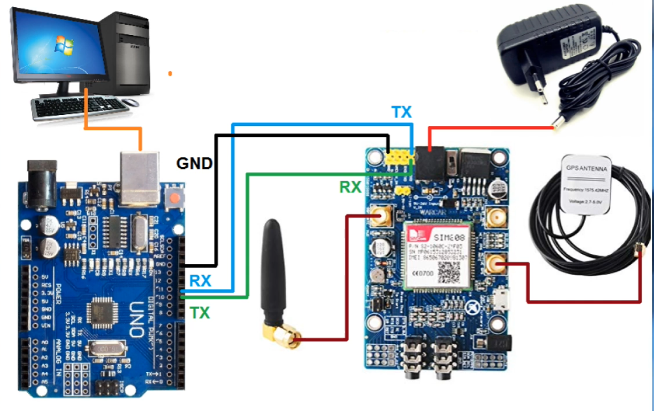
HARDWARE IMPLEMENTATION

Slide 13
SOFTWARE PROTOTYPE
Android High fidelity prototype

